Slide 1
Bear Budget
Ethan Robinson, Timmy Frederiksen, Trae Stevens, Will Henderson

Slide 2
Analysis - Bear Budget
Our vision for the project is a personal budgeting tool. We plan to implement features such as allowing users to categorize spending, subdivide the categories, identify trends in their spending, and comment on each section of spending. The system will also allow the user to edit the amount of money they currently have available to spend, as well as display the amount of money they will have left over after expenses. The user will be able to differentiate between essential & non-essential expenses. The system will also be able to track how much money has been spent on a given category over a given amount of time. There will be a heavy emphasis on a user-friendly visual interface with simple terminology.

Slide 3
Wireframes
Login System
Main Menu
Expense Menu

Slide 4
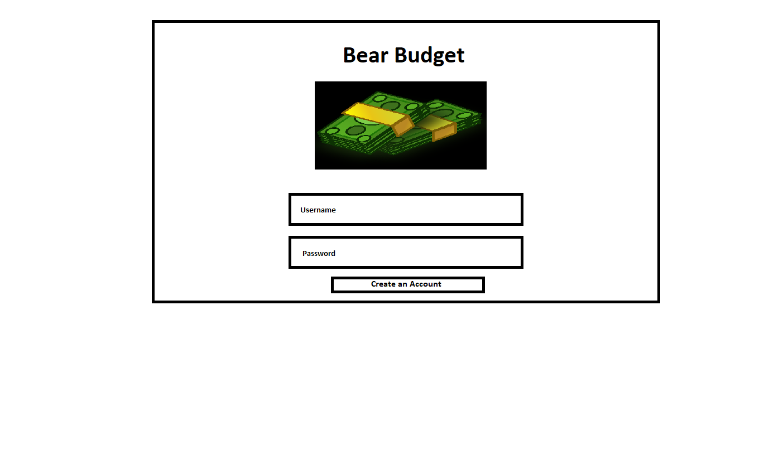
Login System

Slide 5
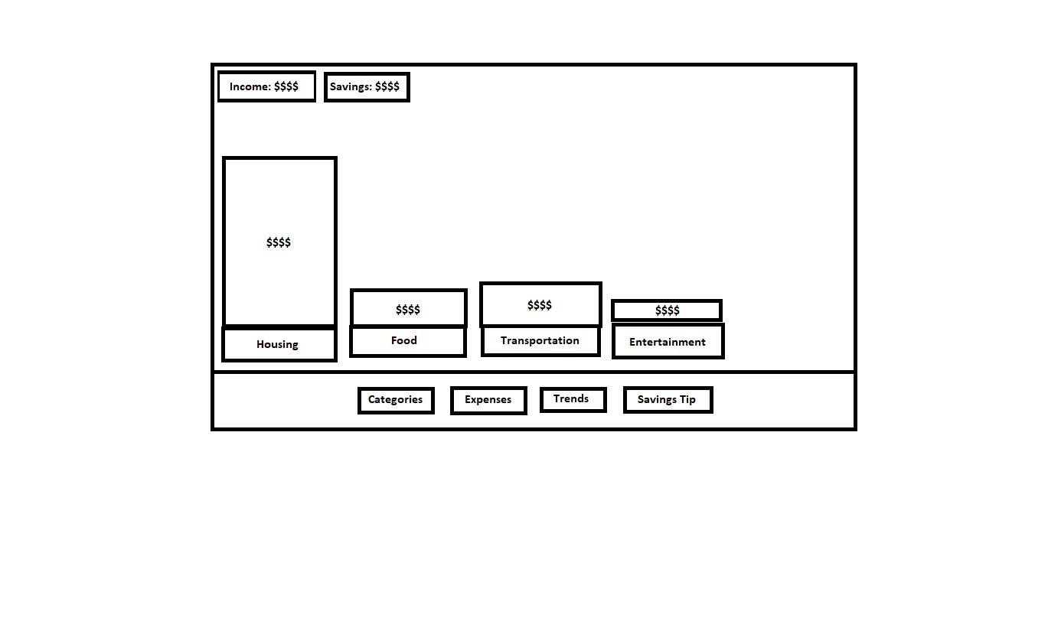
Main Menu

Slide 6
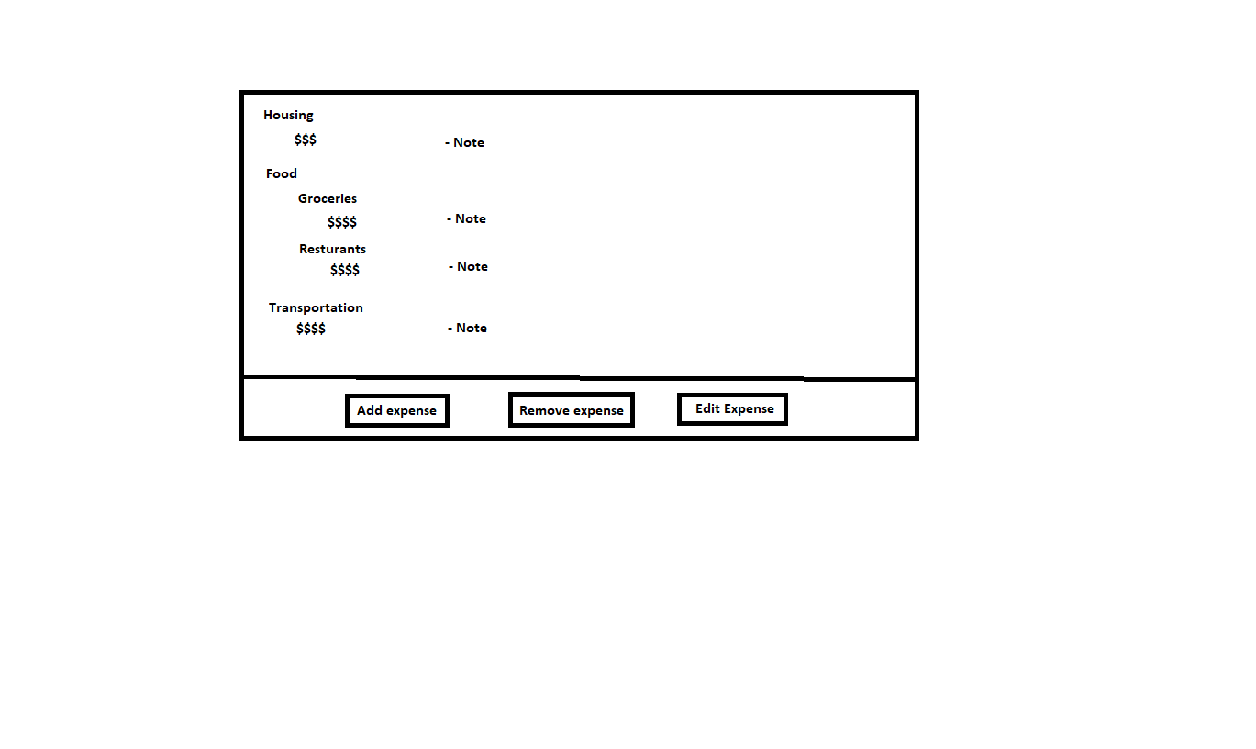
Expense Menu

Slide 7
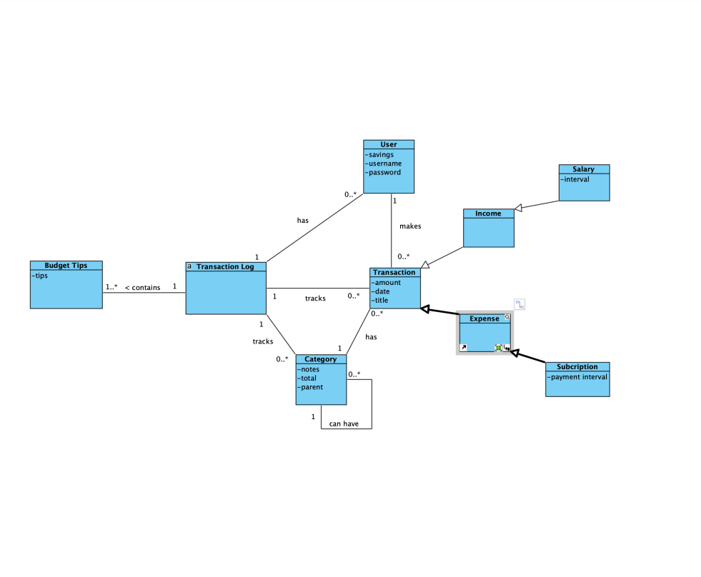
Domain Model

Slide 8
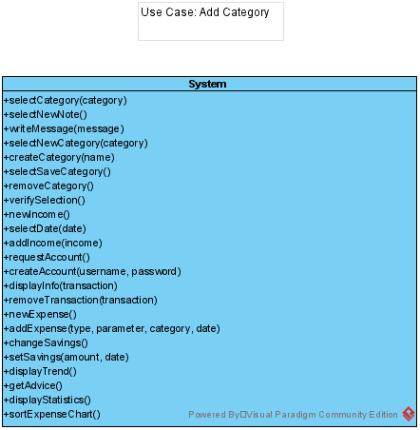
Operations

Slide 9
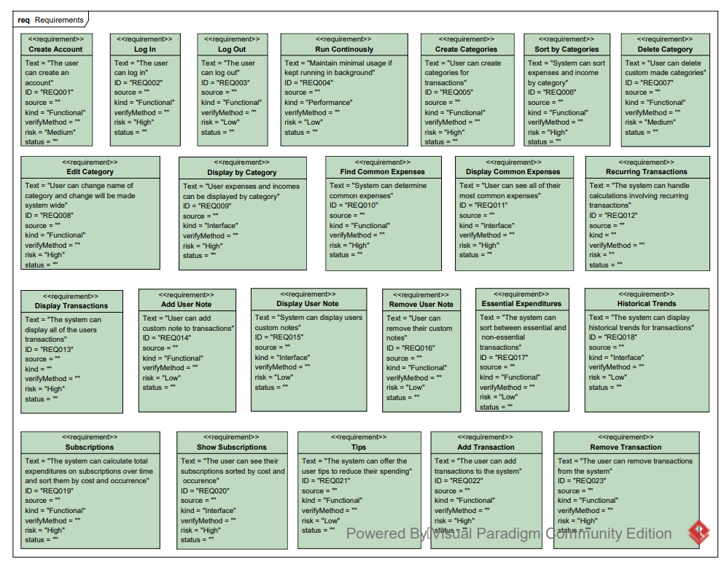
Requirements

Slide 10
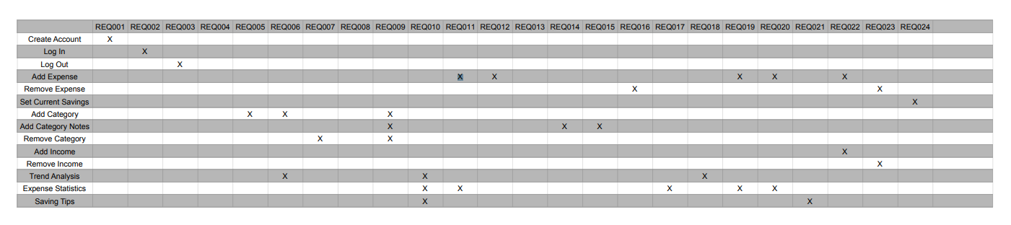
Traceability Matrix

Slide 11
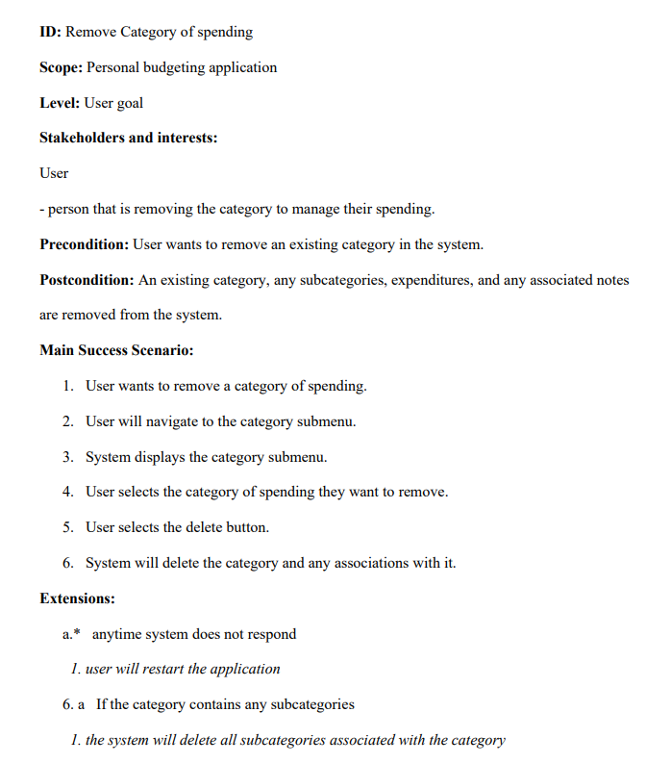
Use Cases

Slide 12
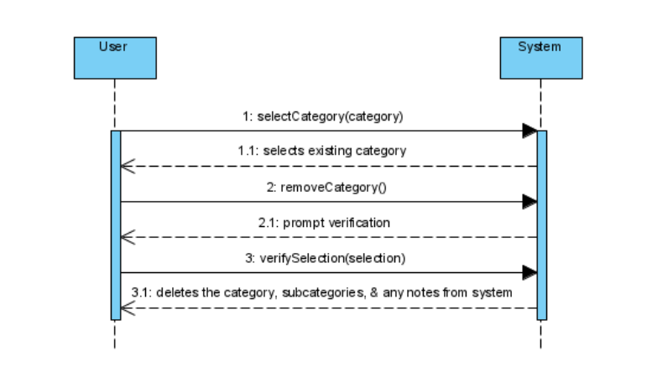
SSD

Slide 13
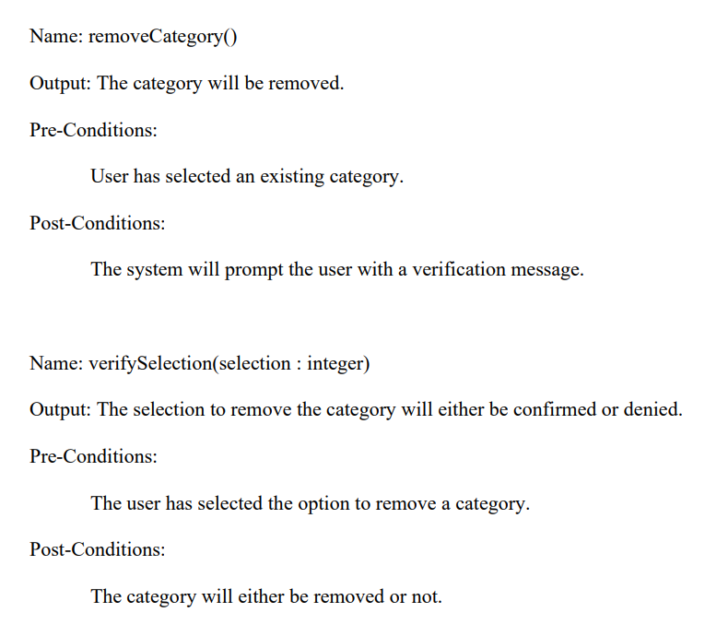
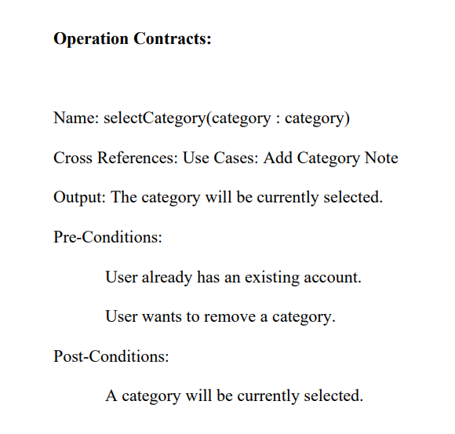

Slide 14
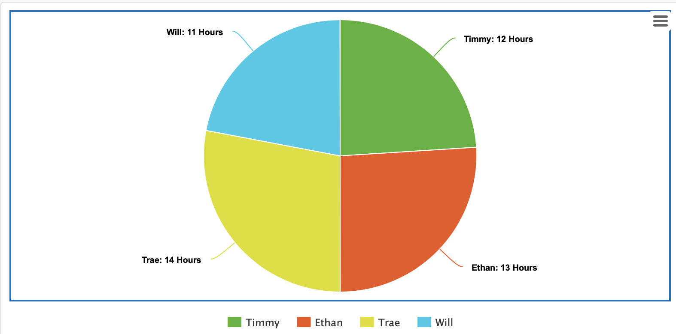
Ticketing

Slide 15
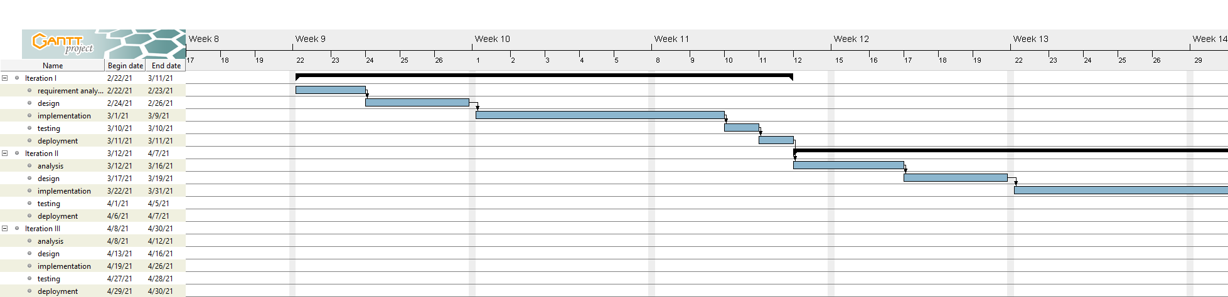
Gantt Diagram

Slide 16
Gantt Diagram

Slide 17
Websites
https://financemanagerapp.weebly.com
https://github.com/someuntakenusername/CSISWENGSpring2021

